Slide 1
Reinventing Academia
Open Science & Independent Scientists
Rebecca Willén (PhD)
IGDORE
www.igdore.org

Slide 2
TODAY’S SEMINAR
1. Openness, Open Science & Replicability
2. Independent scientists
3. Location independence
4. Coworking
5. IGDORE

Slide 3
OPENNESS / TRANSPARENCY MOVEMENTS
- Open Source (1985-)
- Open Government
- Open Education (around 2000-)
- Open Science (around 2000-)
- Open Access
- Open Science (2011-)
- Open practices: preregistration, open data / material / reports / code, open peer review, transparent reporting

Slide 4
REPLICABILITY CRISIS / MOVEMENT (2011-)
Bad / sloppy scientific practices (Babbage, 1830)
- Questionable Research Practices (John et al., 2011)
Many Labs Replication Project (2014)
- Priming studies not replicated
Open Science Collaboration (Science, 2015)
- 39% of effects rated as replicated
Replicability + Open Practices = True
BUT: Open Science Movement ≠ Replicability Movement

Slide 5
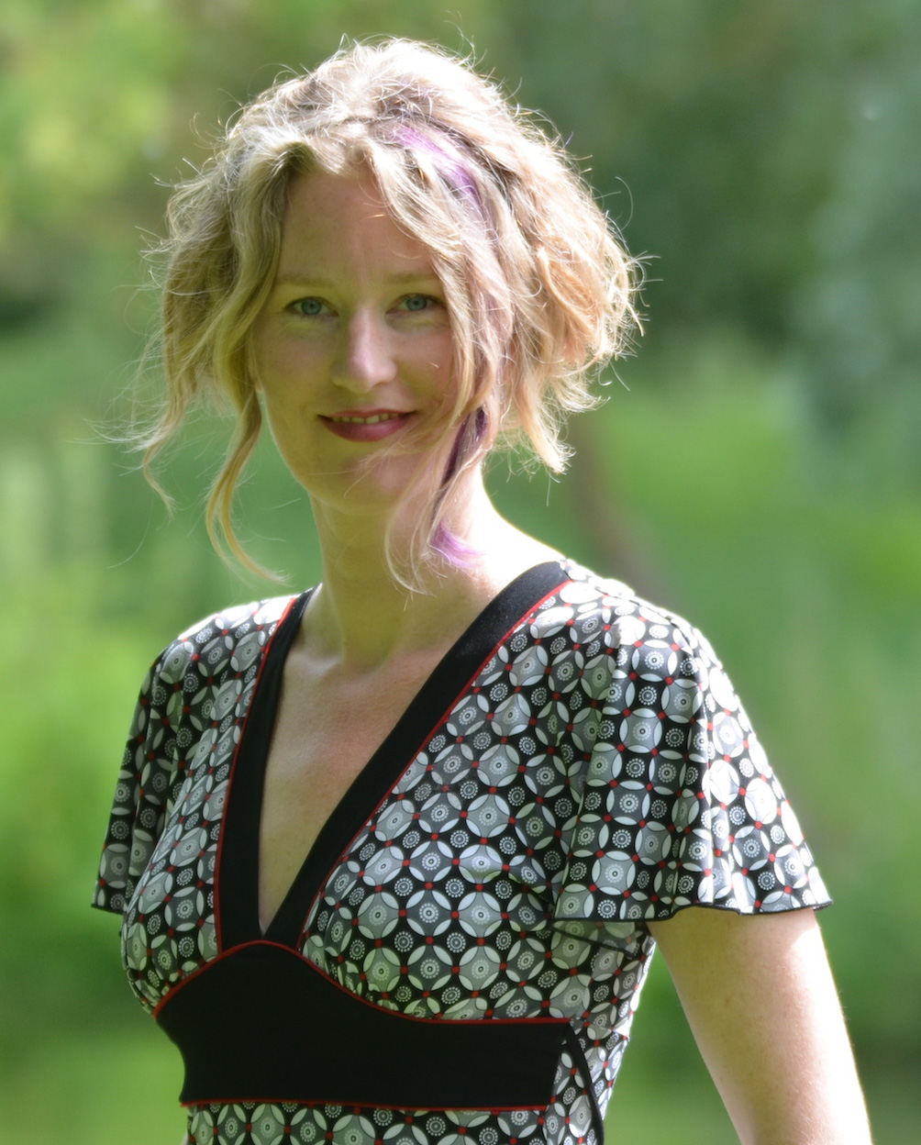
Bullied into Bad Science
Corina Logan (PhD)
Zoologist
Cambridge
http://bulliedintobadscience.org/
Photo: Dieter Lukas

Slide 6
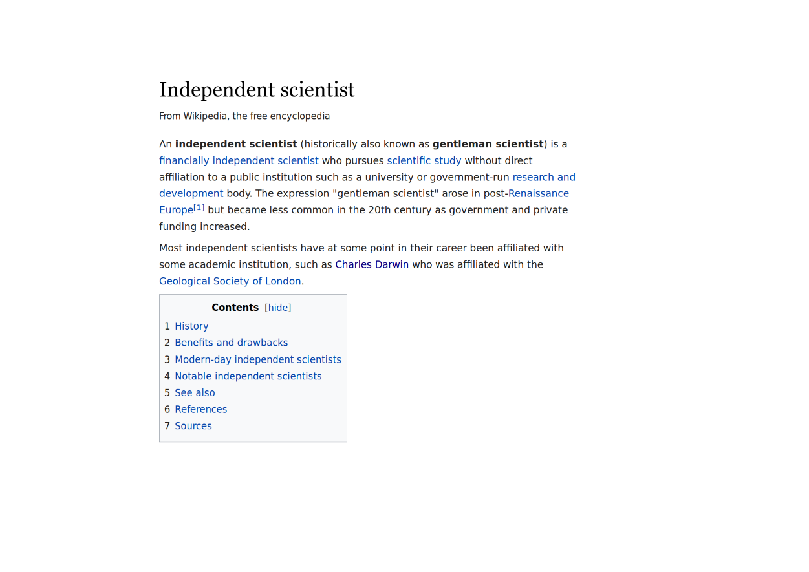
INDEPENDENT SCIENTISTS

Slide 7
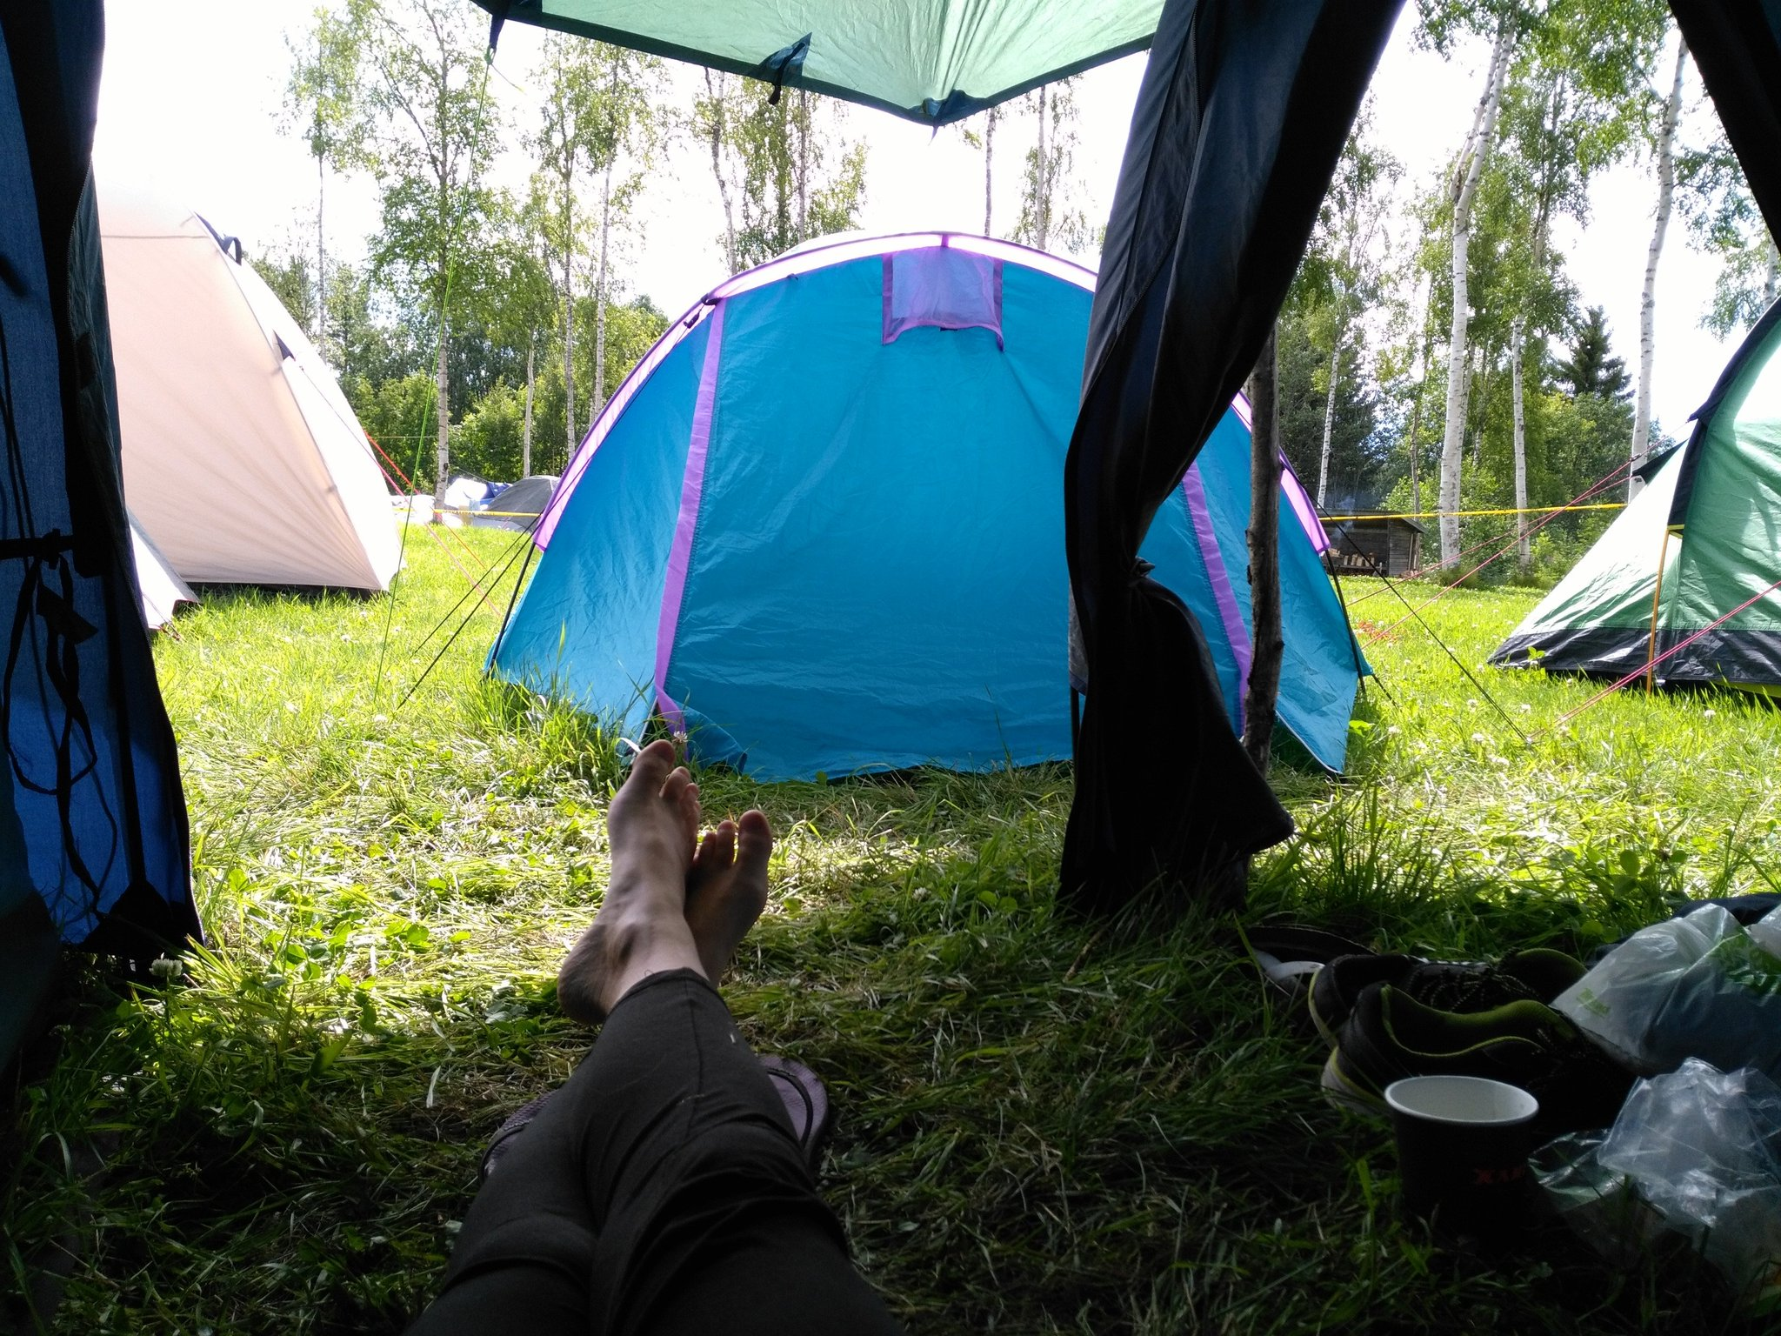
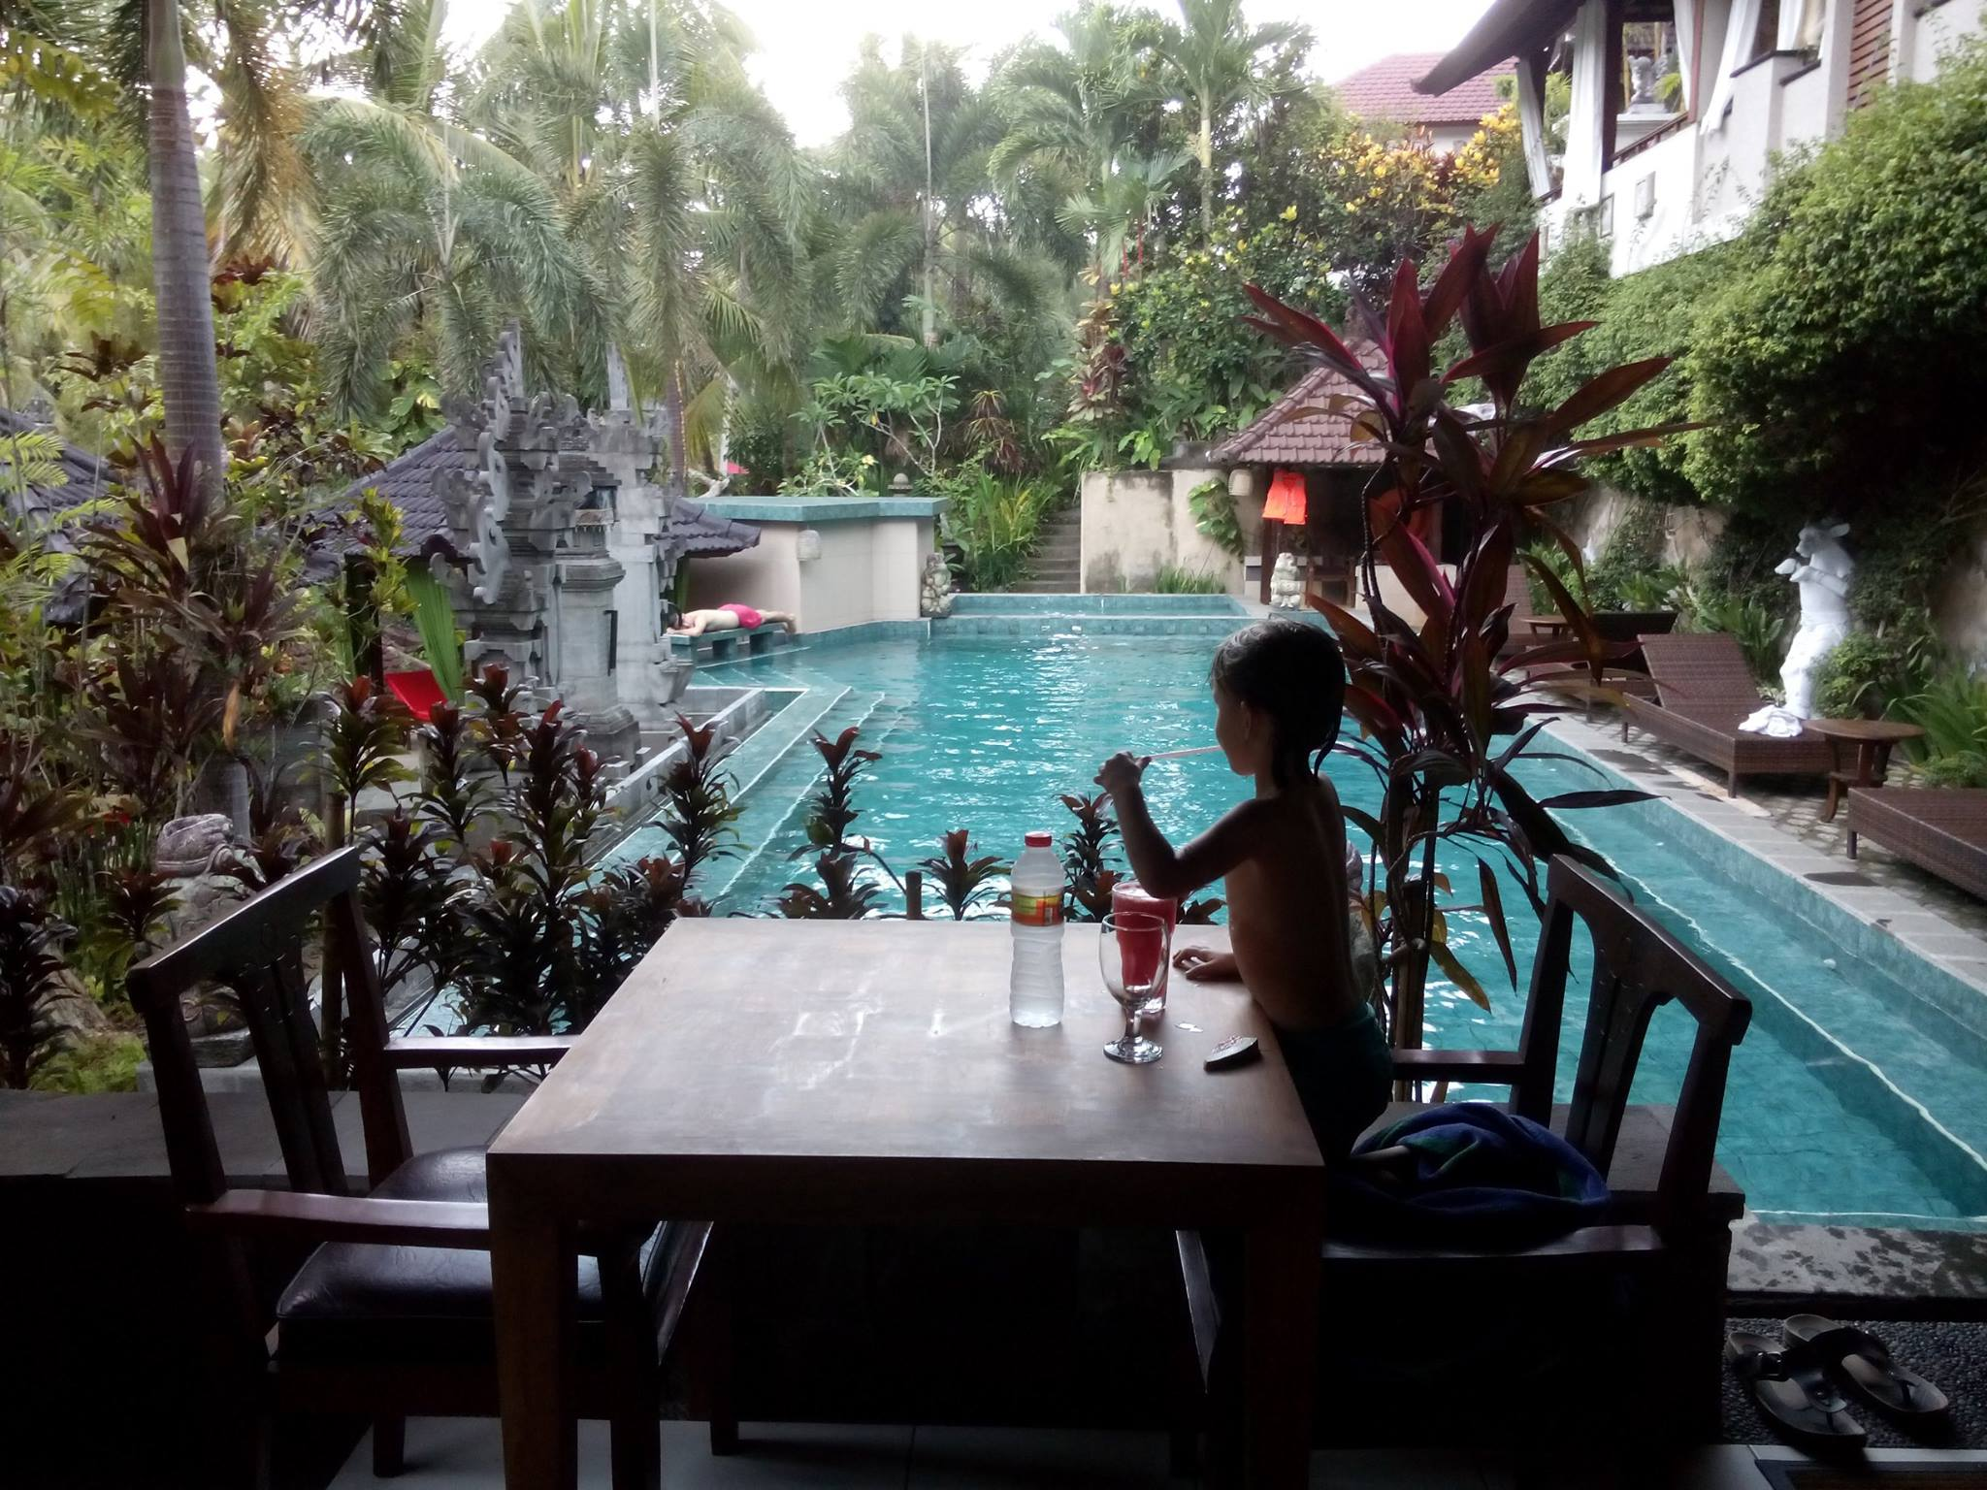
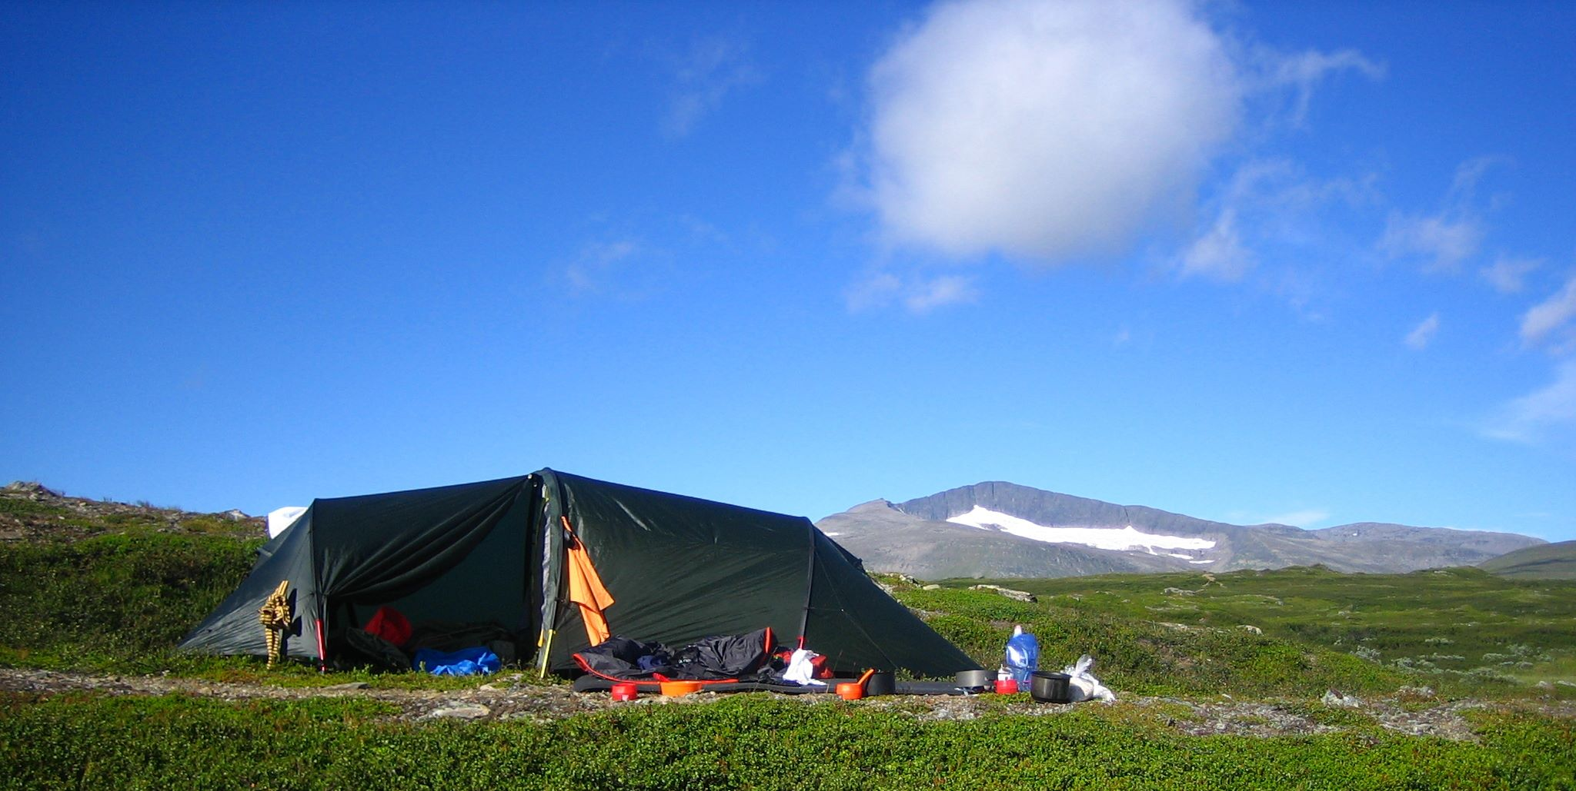
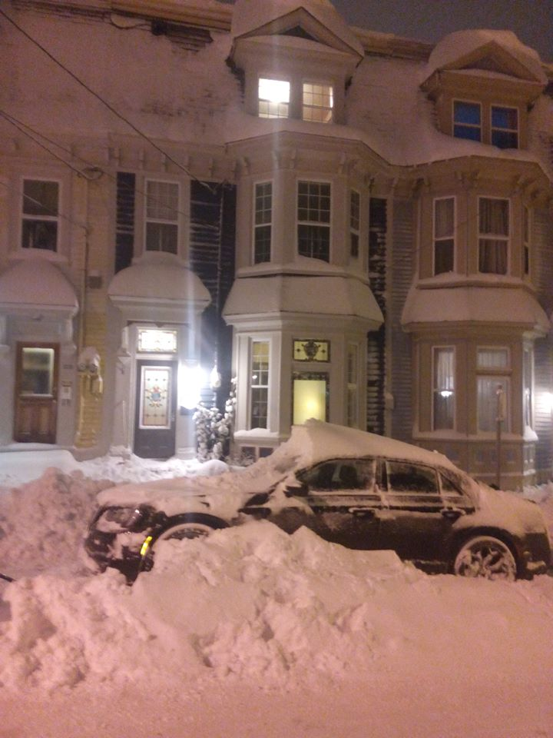
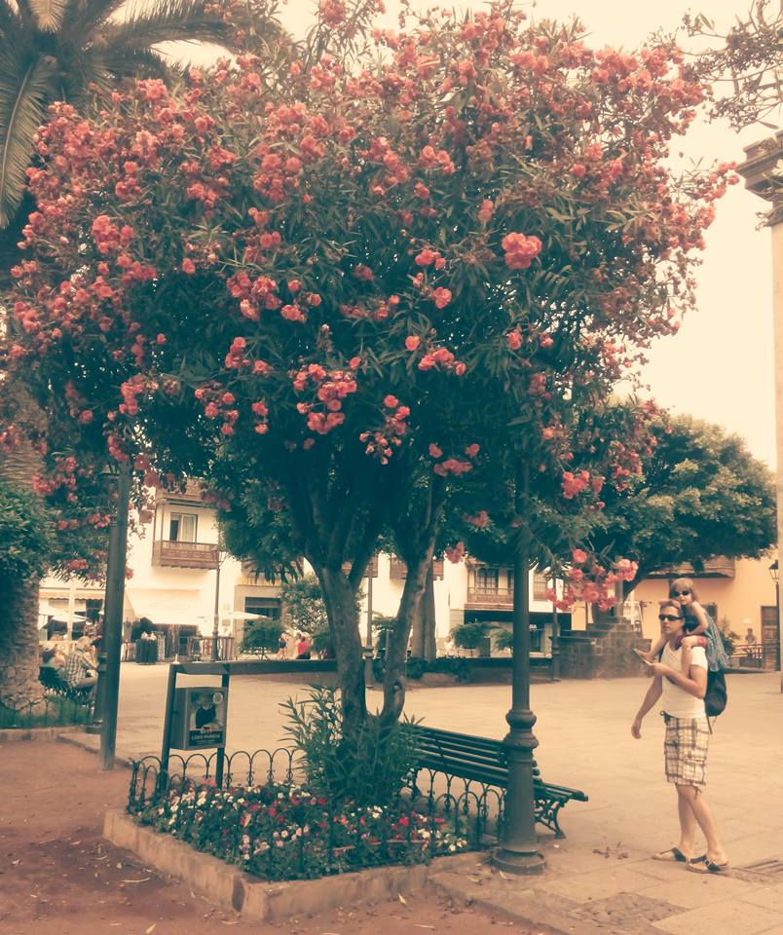
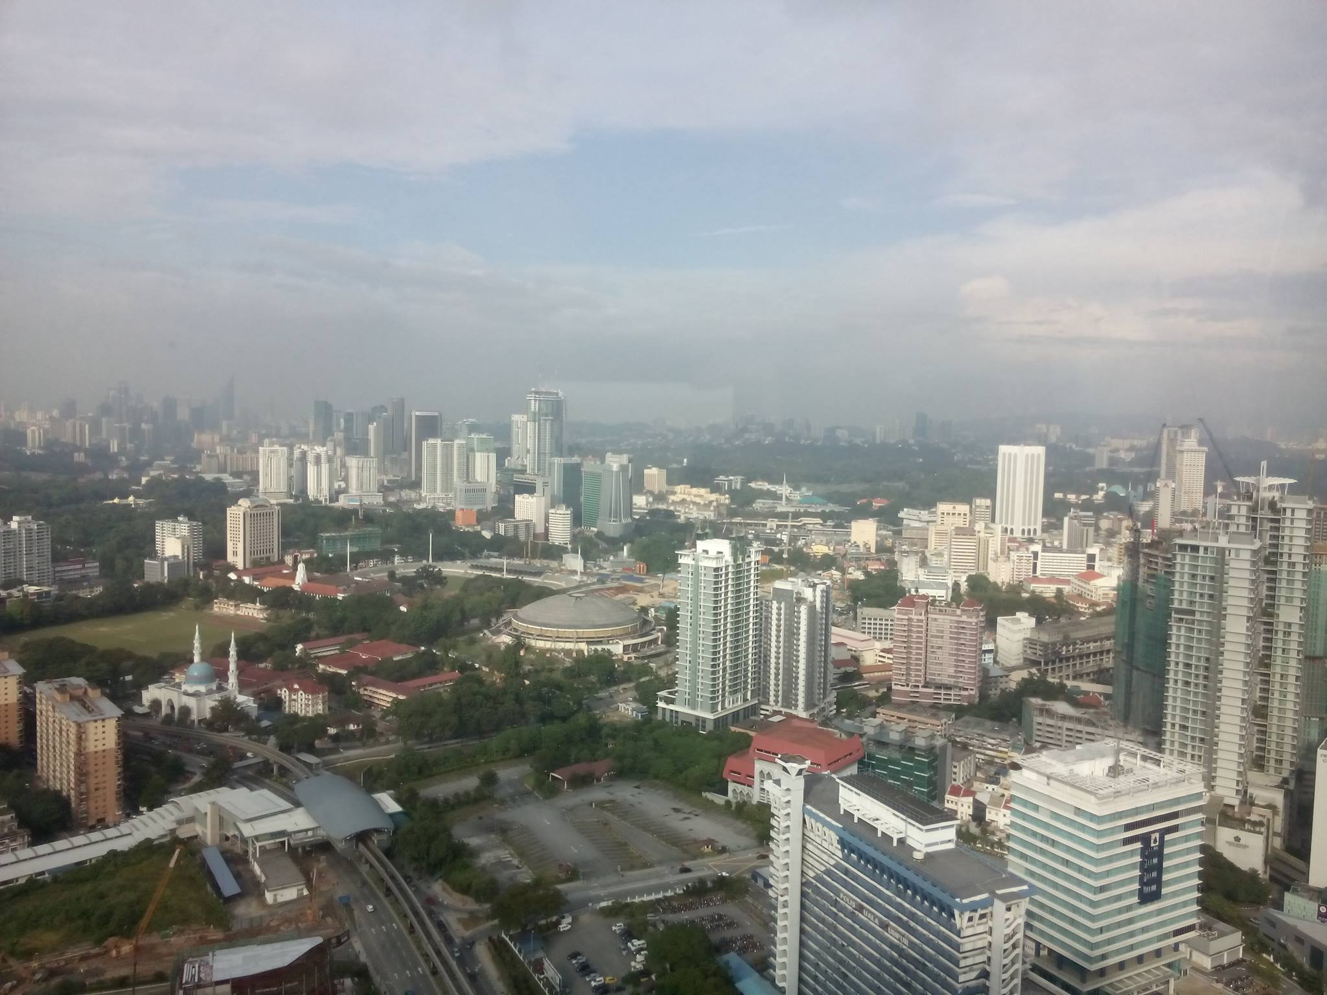
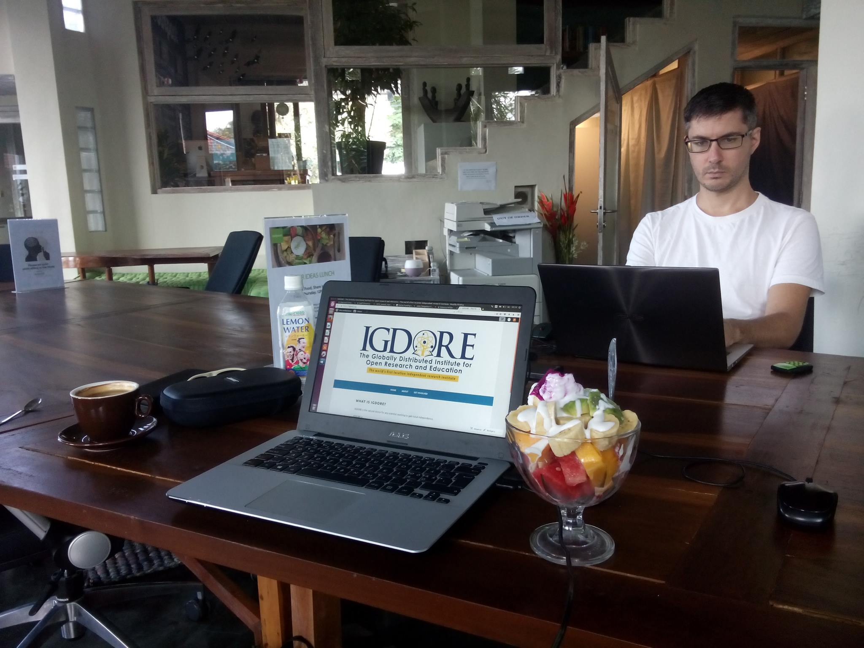
Location independence
Photos: Private

Slide 8
Coworking
Hubud Intro Video:
https://www.youtube.com/watch?v=faBad-JxWh0
Digital nomads:
https://www.youtube.com/watch?v=jkxIVrqfqrg&feature=youtu.be
Photo: Private

Slide 9
Coliving
http://remoteexplorers.com/upcoming/
https://beunsettled.co/locations/
https://www.roam.co/
https://www.swissescape.co/
http://www.alpinecoworking.com/
http://www.mokrinhouse.com/house-gallery/

Slide 10

IGDORE
Healthy, Global & Transparent Science
Healthy science
Good work environment
Work-life balance
Global science
Wordwide recruiting
Worldwide data collections
Transparent science
Good science (open scientific practices)

Slide 11
IGDORE
Current researchers, assistants & staff
Malin Hildebrand Karlén (researcher; Sweden)
Etienne LeBel (researcher & board member; Canada)
Rebecca Willén (researcher & board member; Indonesia & Sweden)
Alethea Hui Qin Koh (research assistant; Japan & Singapore)
Ruben Dieleman (research assistant; Sweden)
Daŝa Kokole (research assistant; Netherlands)
Paulina Gruffman (research assistant; Sweden)
Daniel Berntsson (investor & board member; Indonesia & Sweden)
Petra Sinatria (adminstrative coordinator; Indonesia)
Nano (receptionist; Indonesia)

Slide 12



IGDORE
Healthy – Global – Transparent
Sweden
Grant hosting
Data collection
Indonesia
Coworking space
Data collection
Grant hosting
Estonia
International team of research assistants
Grant hosting

Slide 13
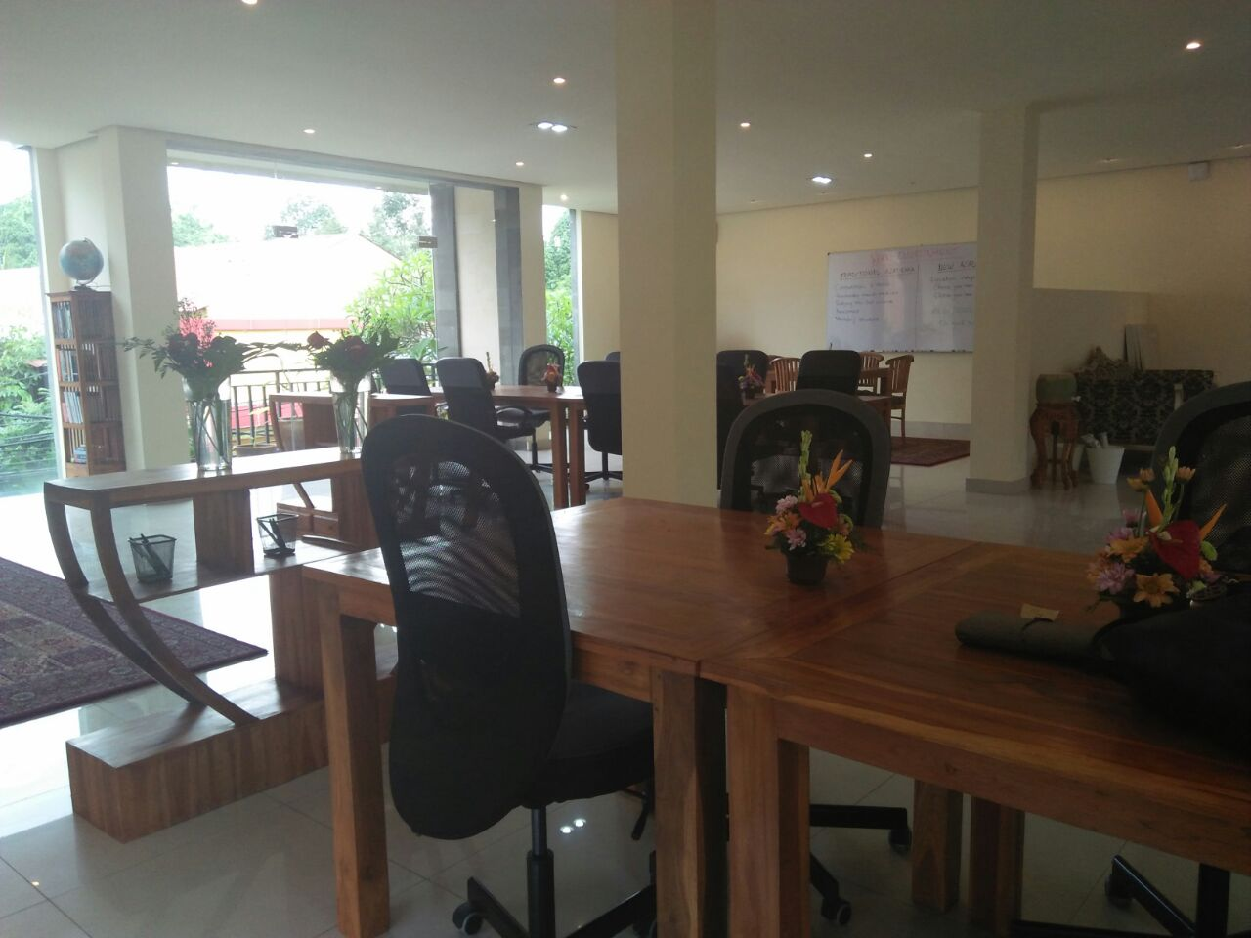
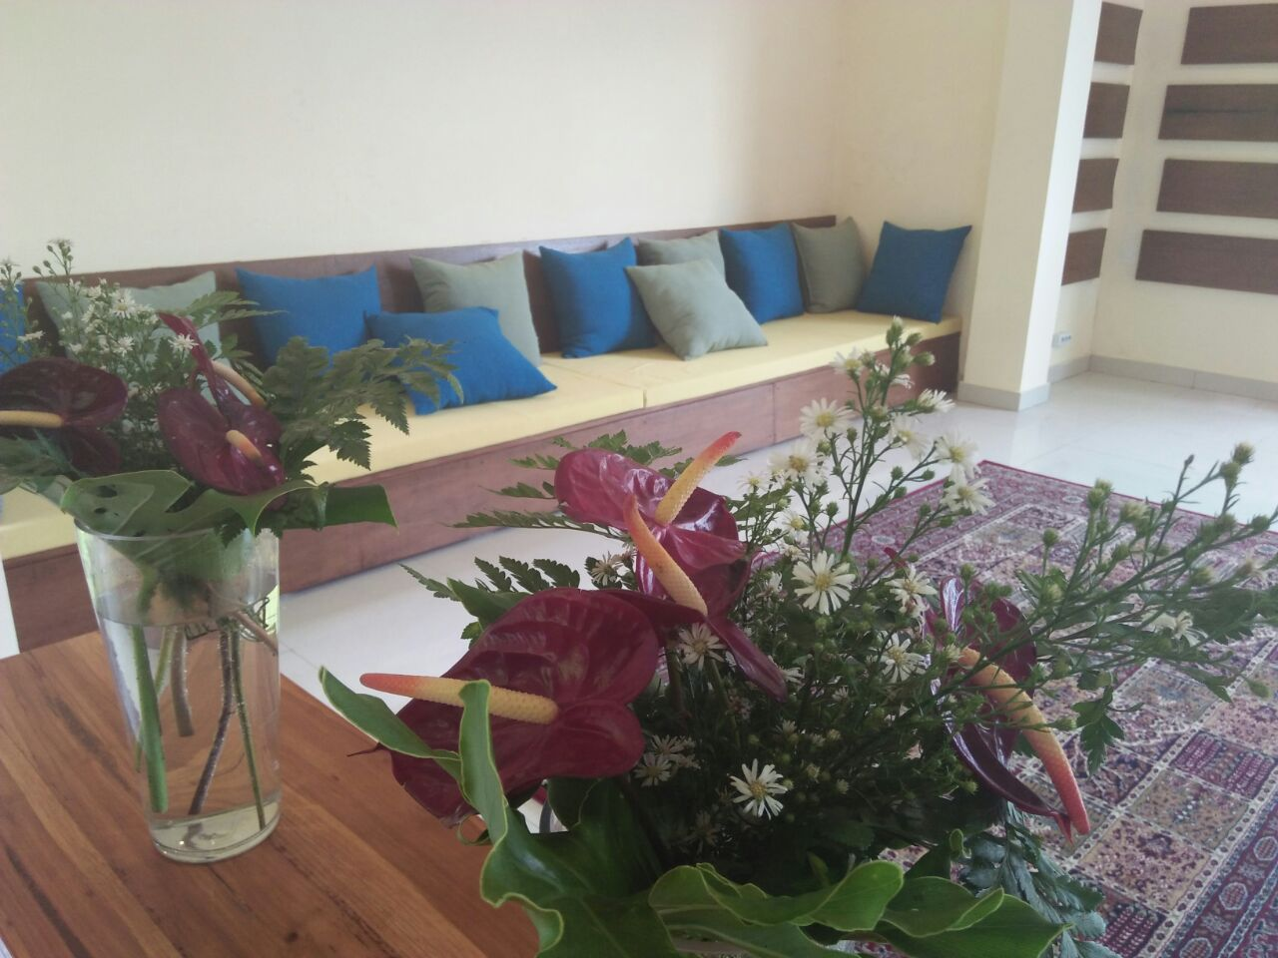
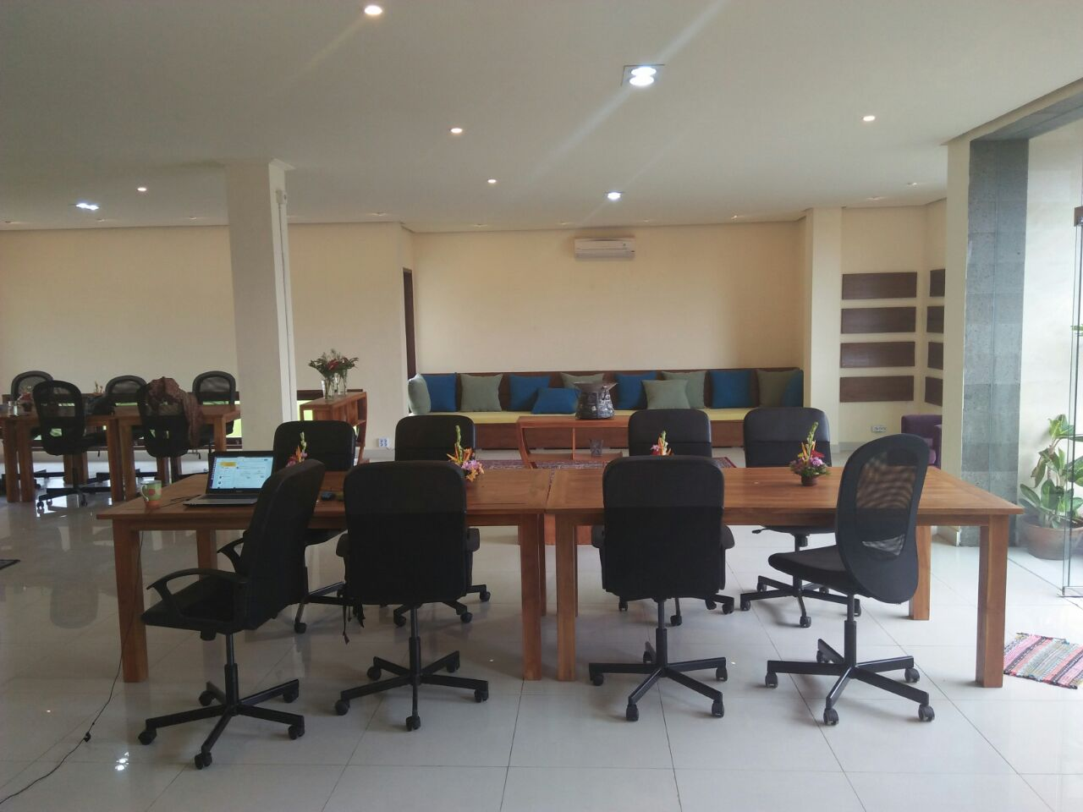
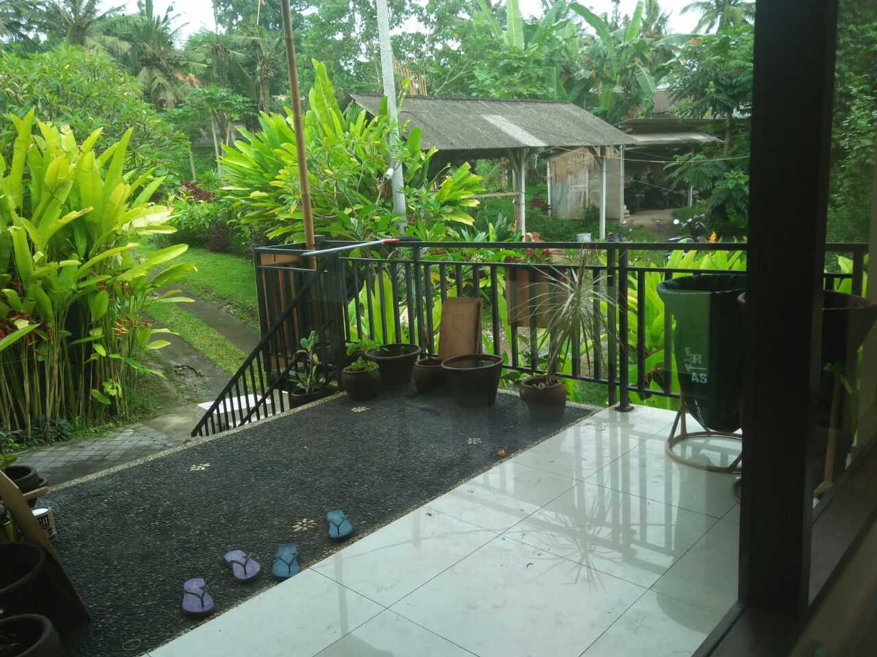
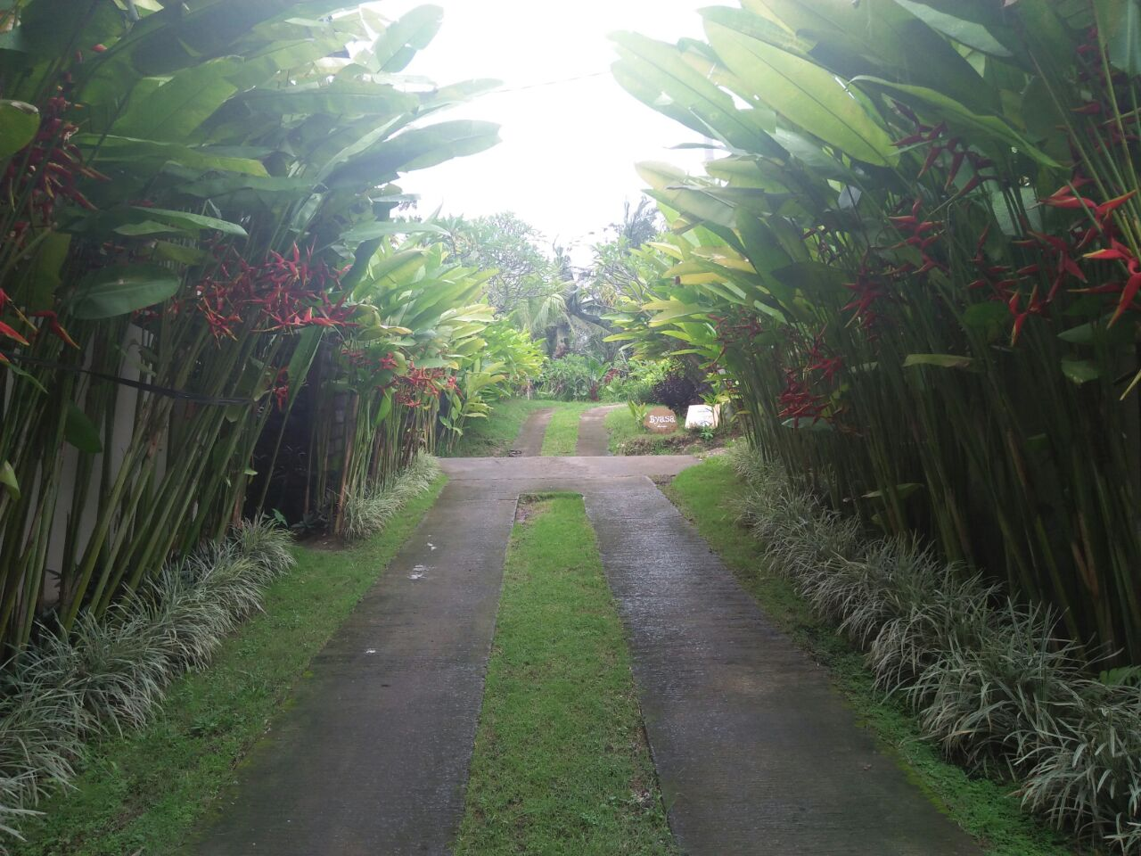
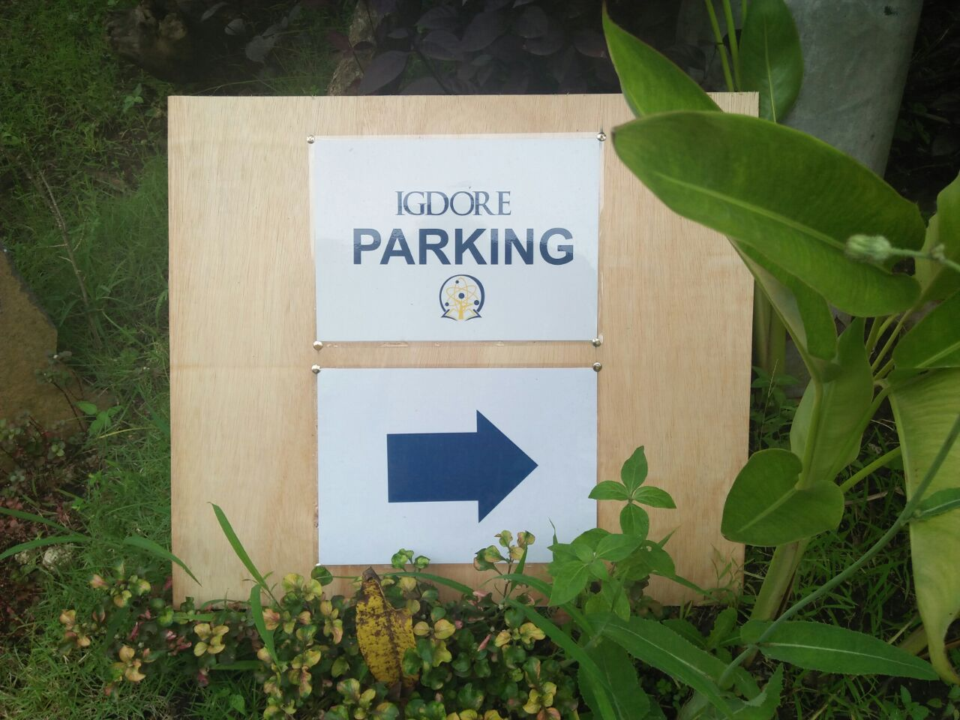
IGDORE Indonesia
Coworking space for scientists & students
Photos: Petra Sinatria, IGDORE

Slide 14
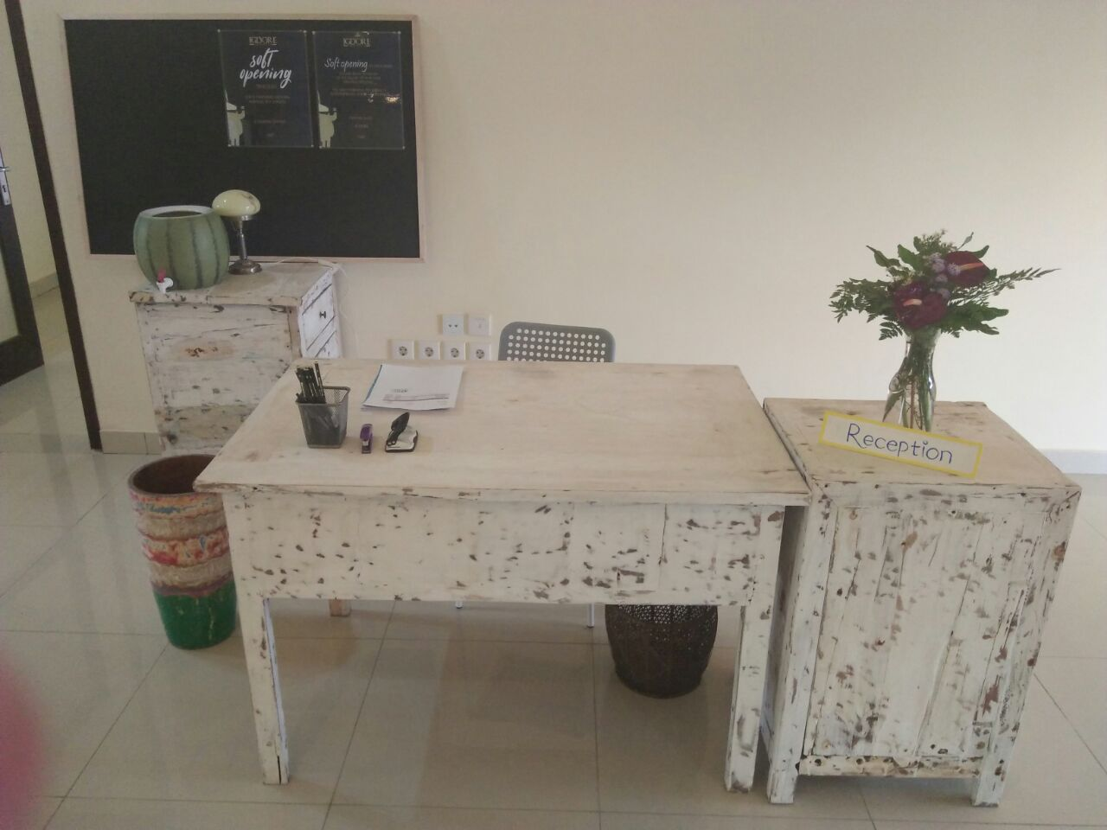
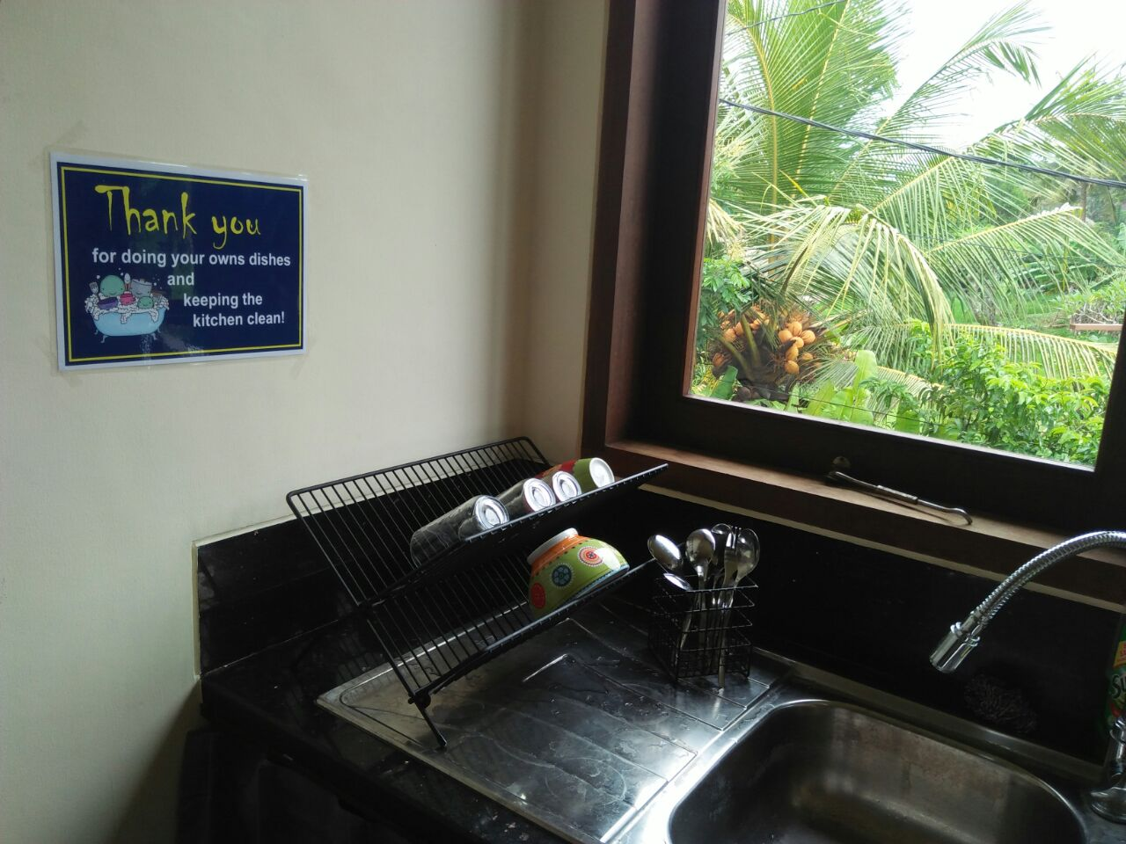
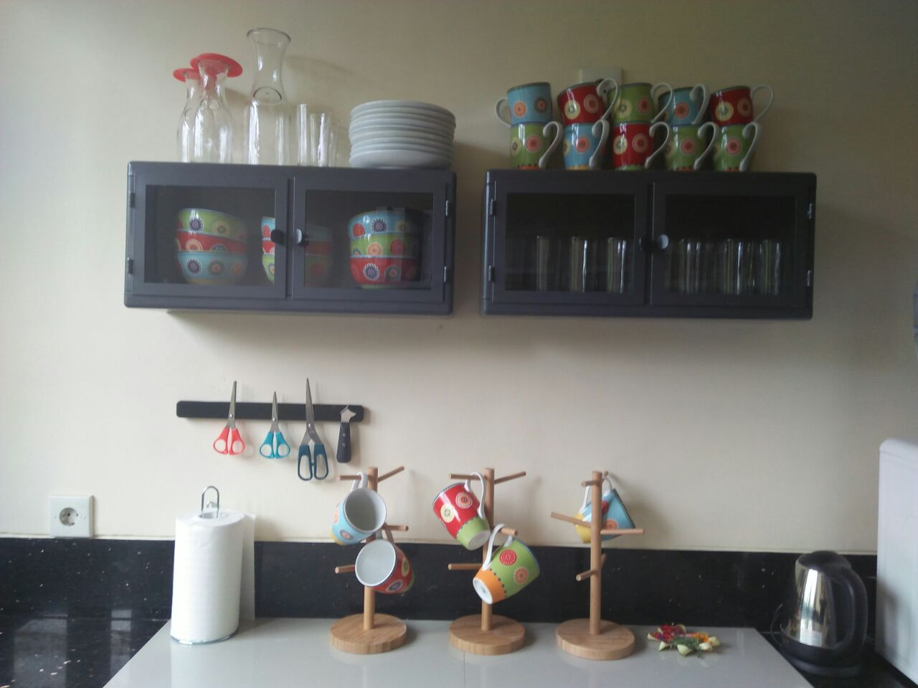
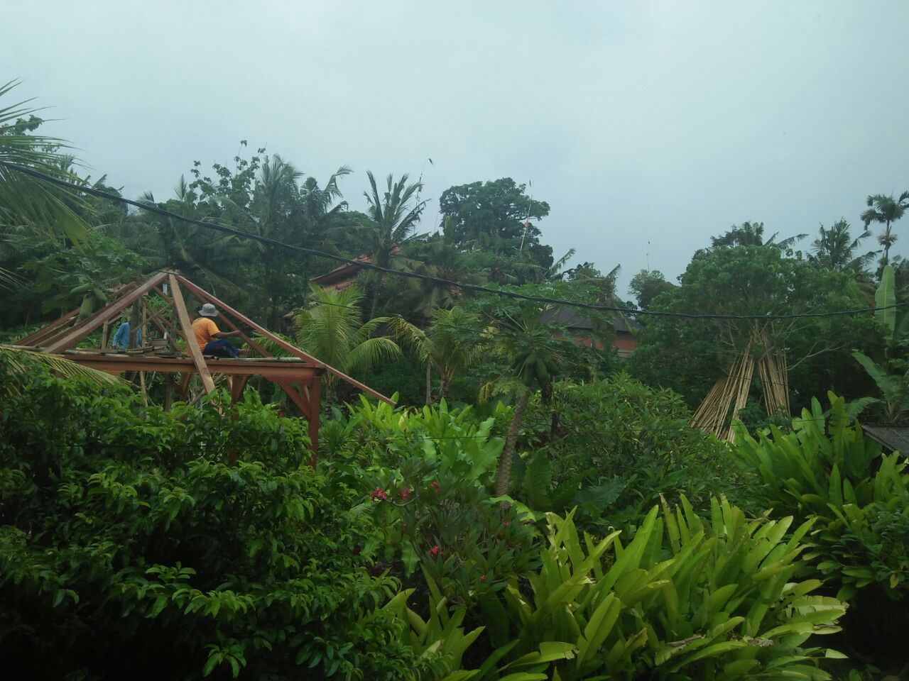
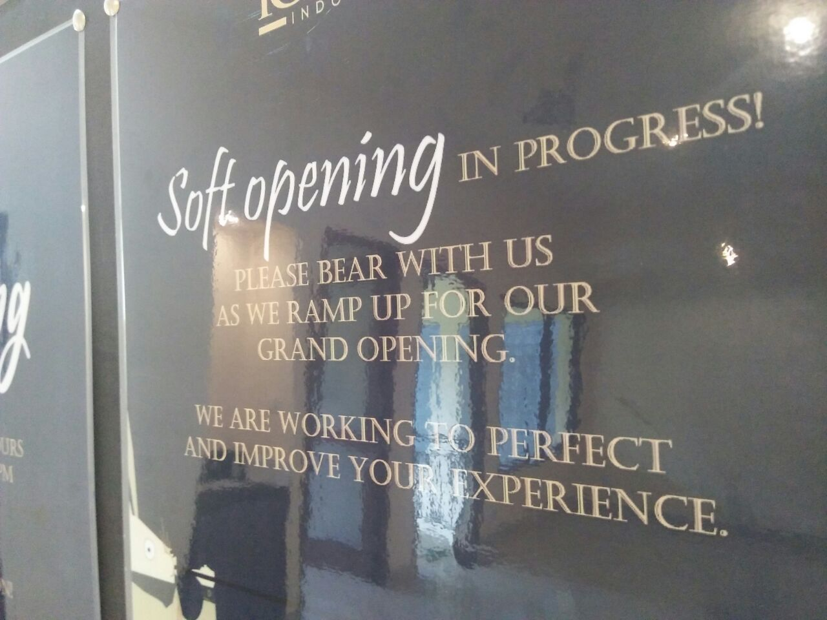
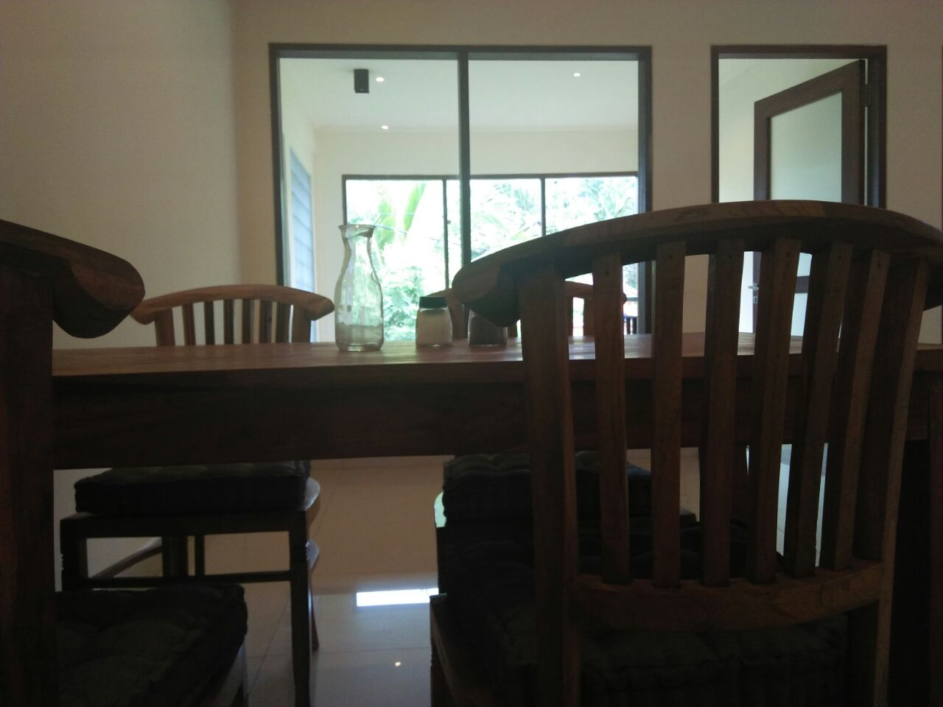
IGDORE Indonesia
Coworking space for scientists & students
Photos: Petra Sinatria, IGDORE

Slide 15
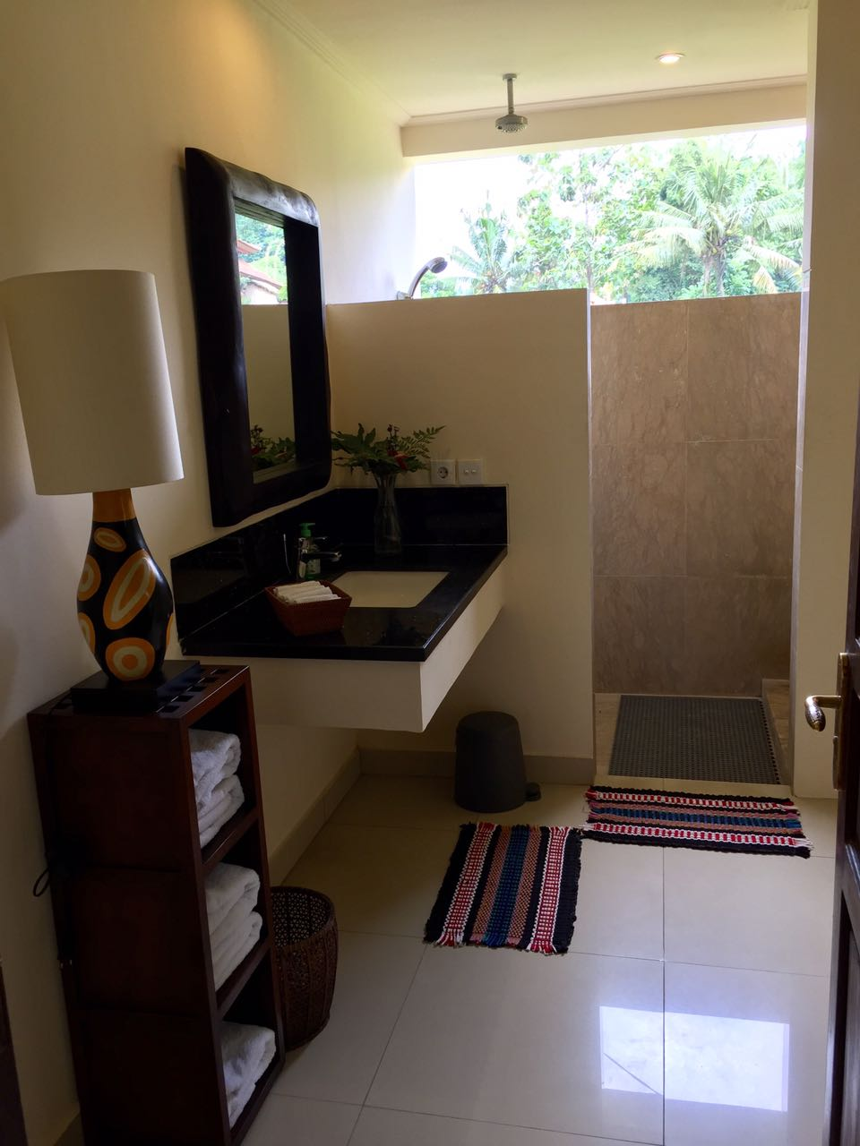
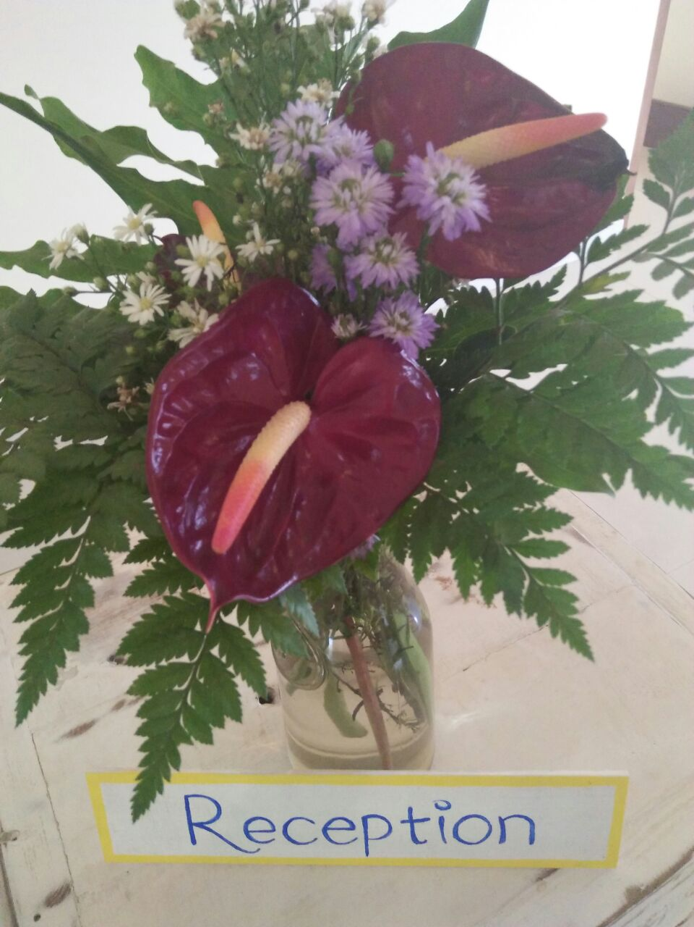
IGDORE Indonesia
Coworking space for scientists & students
Photos: Petra Sinatria, IGDORE

Slide 16
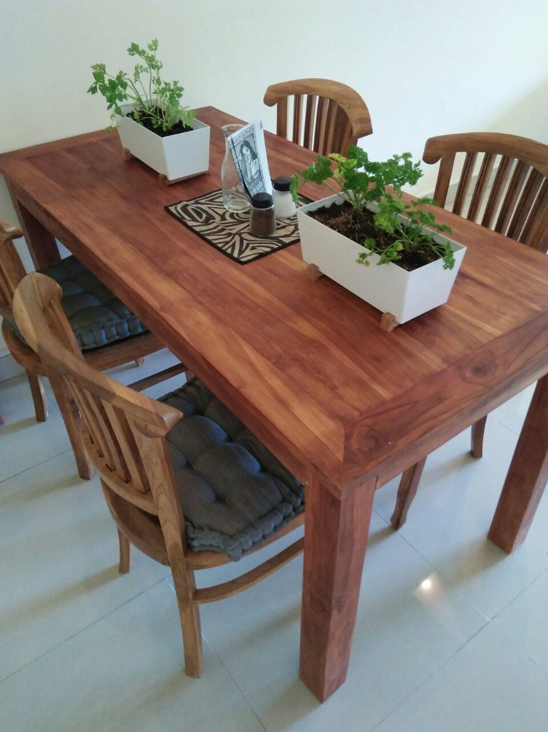
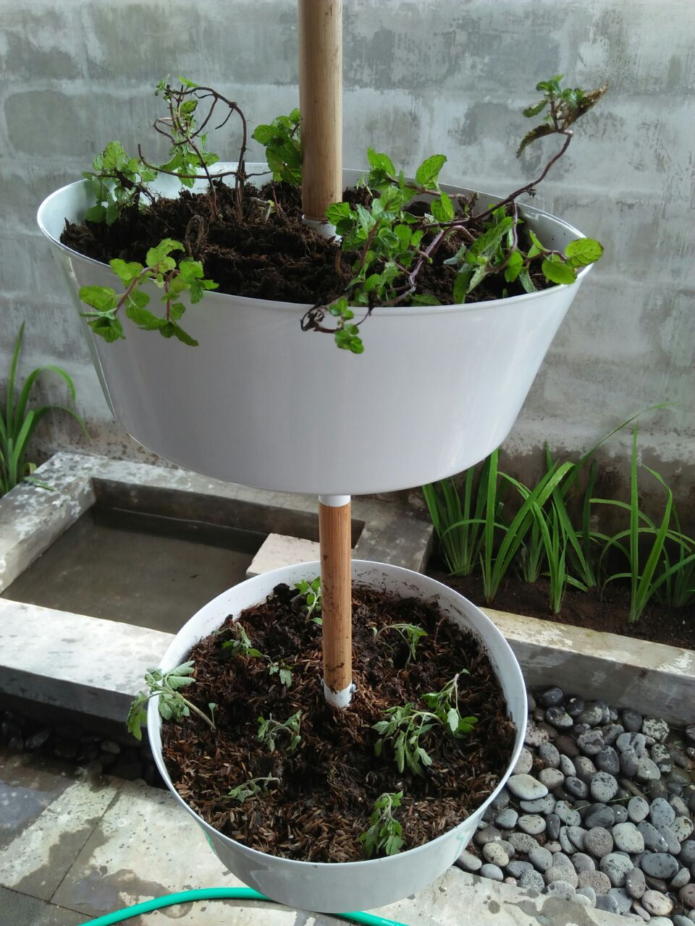
IGDORE Indonesia
Coworking space for scientists & students
Photos: Petra Sinatria, IGDORE

Slide 17
Scientific Openness Support
Preregistration
Transparent reporting
Open data (& open code)
Open material
Open reports
Thorough planning of sample size
Direct replications
Open ethical review

Slide 18
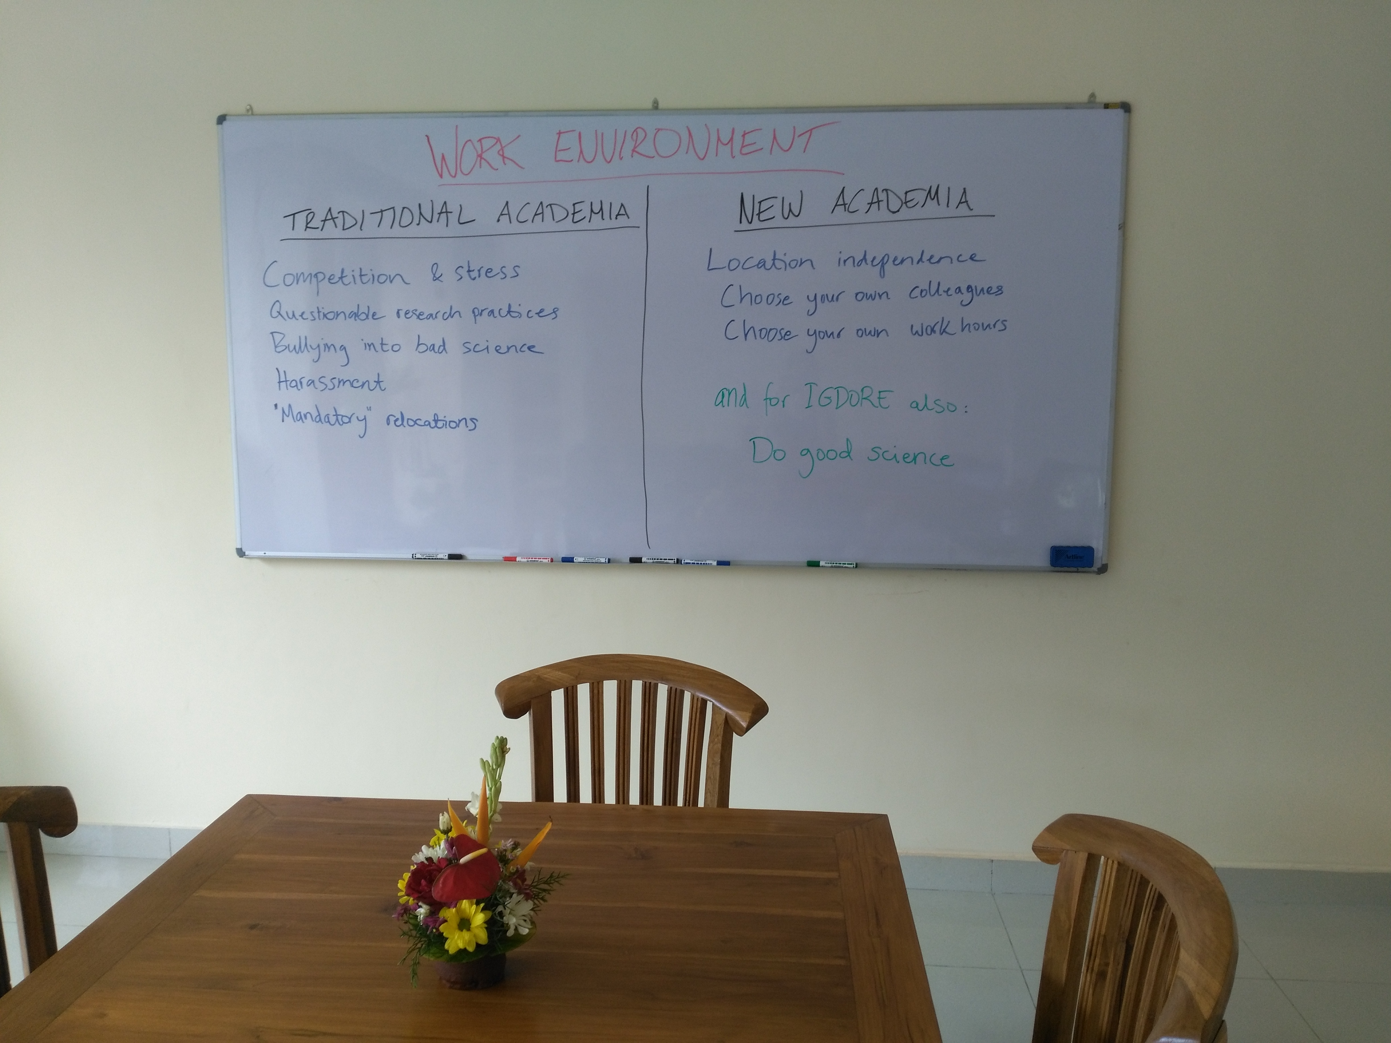
Traditional Academia vs. New Academia
Photo: IGDORE

Slide 19
Affiliation with IGDORE
formal institutional affiliation
grant management (indirect costs = 0-20%; flexible & negotiable) in Sweden, Estonia and Indonesia
opportunity to offer tuition and certain types of consultancy through us (i.e. we take care of billing and other administration for a small fee)
access to our international team of experienced research assistants at cost price
free access to our coworking space on Bali, Indonesia
free VPN service via Mullvad.net

Slide 20
Other virtual institutes & networks for independent scientists
Canadian Academy of Independent Scholars (CAIS): http://www.independentscholars.net/
Complex Biological Systems Alliance (CBSA): http://www.cbsaimtt.com/
CORES Science and Engineering: http://coresscience.co.uk/
Independent Scholars Association of Australia (ISAA): www.isaa.org.au/
National Coalition of Independent Scholars (NCIS): www.ncis.org/
Ronin Institute: http://ronininstitute.org/
Society of Independent Professional Earth Scientists (SIPES): https://sipes.org/

Slide 21
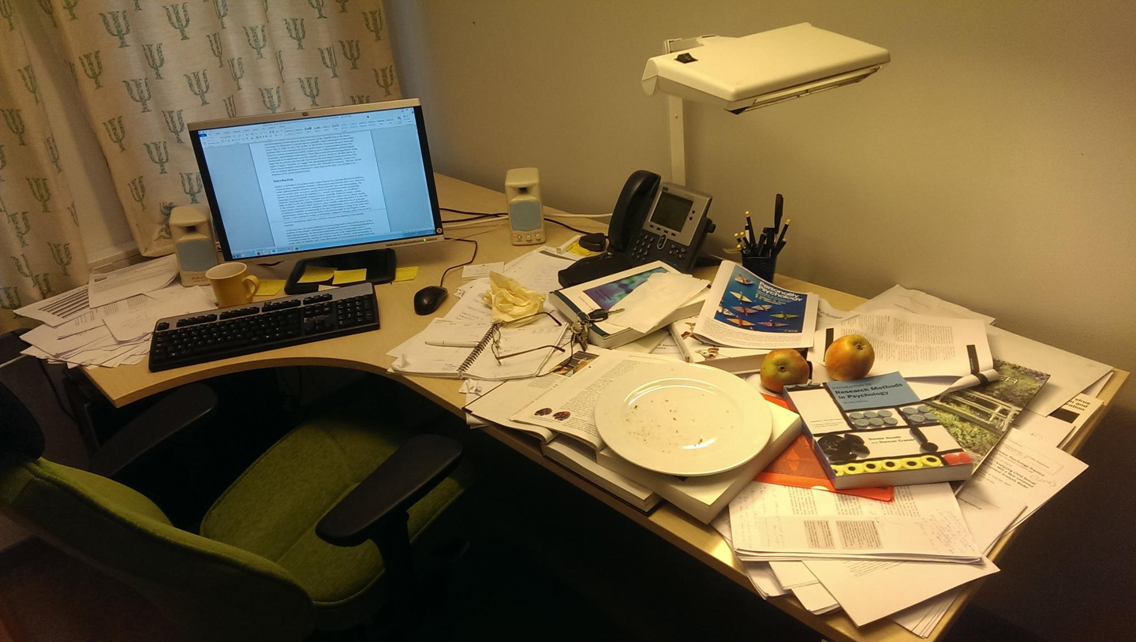
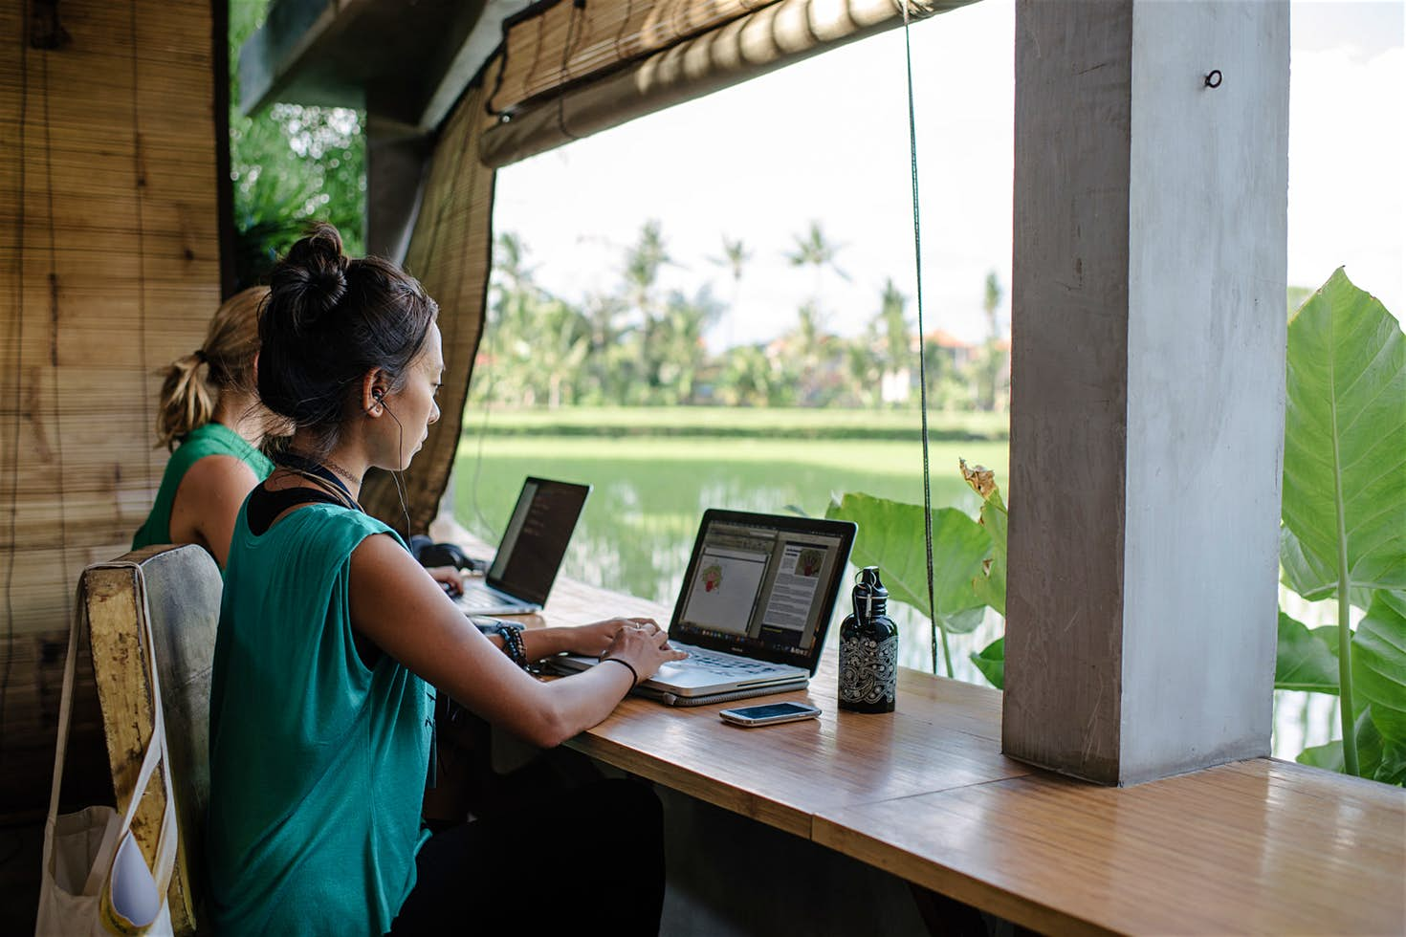
Traditional Academia vs. New Academia
Do reach out! rebecca.willen@igdore.org
Photo: Private
Photo: Franz Navarette / Hubud Bali

